Slide 1
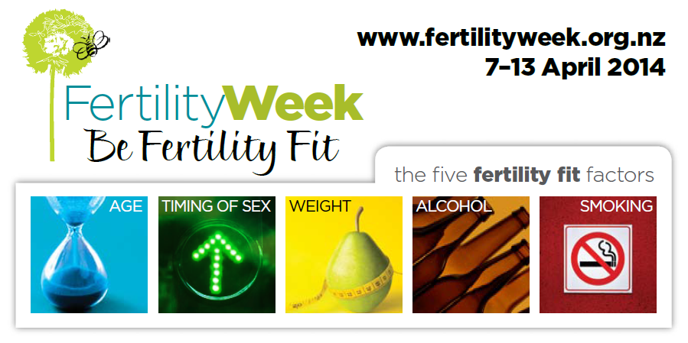

Slide 2
FertilityNZ
Exists to support New Zealanders experiencing fertility problems, whether having difficulties becoming or staying pregnant
Fertility NZ is a registered Charity and has been dedicated to supporting people faced with fertility issues for over 20 years

Slide 3
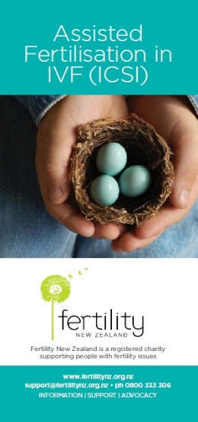
What does FertilityNZ do?
1. Information
www.fertilitynz.org.nz
Email contact and 0800 number
Dandelion newsletter
Fact sheet brochures
Information videos
Seminars and workshops
Facebook page

Slide 5
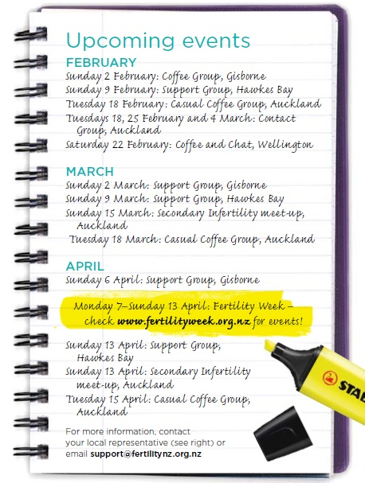
What does FertilityNZ do?
2. Support
9 Regional support groups
Contact groups
Coffee groups
Seminars
Conferences

Slide 6
What does FertilityNZ do?
3. Advocacy
Provide a national voice for people affected

Slide 7
Our Vision
FertilityNZ has a vision of a ‘fertility friendly’ and fertility-aware New Zealand where:
Infertility is recognised, understood and supported
All men and women faced with the medical condition of infertility have access to appropriate, timely and fully-funded medical treatment
Men and women have all the information necessary to enable them to make informed decisions regarding their fertility
Young New Zealanders learn about fertility preservation
Fertility and all alternative forms of whanau and family-building are respected and valued

Slide 8
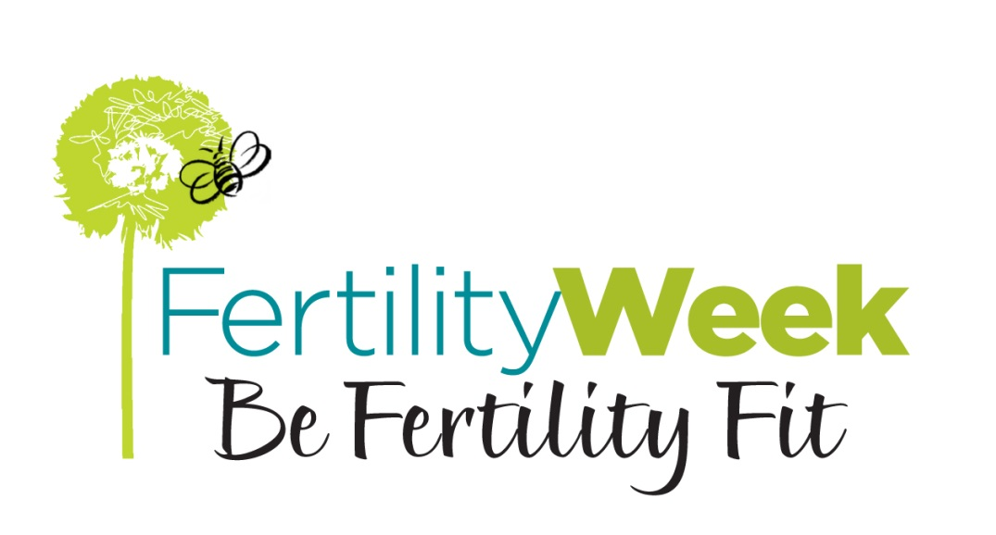

Slide 9
Key Factors Impacting Fertility
Age – having an awareness of how age affects fertility
Timing of sex - awareness of intercourse timing and frequency relative to ovulation
Weight – ensuring a healthy body weight (BMI 20-25) by exercising regularly and having balanced, nutritious diet
Alcohol – avoiding alcohol and recreational drugs during or when planning a pregnancy
Smoking - avoiding smoking and minimising exposure to other toxic environmental chemicals.

Slide 10
Why Fertility Fitness?
NZ statistics driving this campaign
1 couple in 6 is infertile
1 couple in 5 experiences miscarriage
1 woman in 10 experiences toxemia
1 woman in 8 experiences gestational diabetes
1 woman in 5 has a caesarian
1 baby in 10 is premature or small for dates
1 baby in 30 has a congenital defect
1 woman in 6 has some post natal depression
1 child in 10 is affected by learning or behavioural problems
1 child in 4 suffers from asthma
http://www.health.govt.nz/nz-health-statistics

Slide 11
Fertility Fitness / Preconception Care
Increases chances of a healthy conception and pregnancy
Significant impact on our children and their health development over their lifetime
Liggins Institute - important work on perinatal health and long term consequences to offspring

Slide 12
Epigenetics
Fetus takes cues from the uterine environment to prepare itself physiologically for the rest of its life
The uterine environment conditions not only the fetus but the germ cells in the fetus, leading to effects in the 2nd generation

Slide 13
Preconception Health Care
The presence of all the factors required for fertility and the creation of a healthy foetus
The absence of all the factors detrimental to fertility and the formation of a healthy foetus
Simply aims for optimal general and reproductive health of both partners to ensure viable fertility and the health of the egg, sperm and ultimately the health of the child

Slide 14
The Critical Four Months
Maturation of ova and spermatogenesis takes 100-120 days, therefore the preconception period is a minimum of 4 months
The instant the egg and sperm combine, an irreversible genetic code is formed for future development of that baby
Health of the egg and sperm reflects health / toxicity of the environment in which they grow

Slide 15
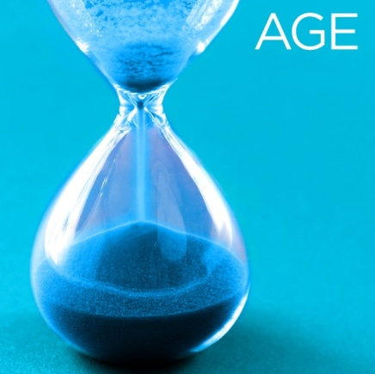
Women
Less than 30 – optimal age
30-34 - relative chance per month reduced by 1/4
35-39 – relative chance per month reduced by 1/2
40-43 – relative chance per month less than 3/4 of a younger woman
44yrs and over – very low chance

Slide 16
Chances of conception

Slide 17
Women
Women over 35 yrs nearly twice as likely to present with unexplained infertility
Incidence of genetic abnormalities and spontaneous abortion increases with maternal age
Chance of miscarriage increases exponentially with age
Pregnancy loss after positive test increases from 25% under 35 y to 50% at 45 y
Chance of chromosomal abnormality increases exponentially with age
- Chance of any abnormality increases from 1:170 at 35 y to 1:11 at 45 y
Over 40 – ineligible for publically funded fertility treatment in NZ
Maheshwari, .A, Hamilton, M., Bhattacharya,S. “Effect of female age on diagnostic categories of infertility.” Human. Reproduction 23, no3 (2008) :538-542

Slide 18
Men
Paternal age significantly related to fertility problems
Increased male age associated with decline in semen volume ,sperm quality and testosterone
After 40 years of age – significantly more sperm DNA damage
Comparisons between men under 30 and those over 50 found relative decreases in pregnancy rates between 23% and 38%
Kidd, S.A., Eskenazi, B., Wyrobek, A.J.”, Effects of male age on semen quality and fertility: a review of the literature.” Fertility Sterility 75, no.2 (2001) :237-48

Slide 19
Men
Advancing paternal age increases risk of autism and schizophrenia
Due to slow accumulation of mutations in stem cells that produce sperm
40 yr old is 50% more likely to father an autistic child than a 20 yr old
Reichenberg.A et al. Arch Gen Psychiatry. 2006;63(9):1026-1032
Notes:
From an individual point of view not a big risk difference 1% to 2%. But from a society-wide perspective, however a doubling in number of people with autism and schizophrenia is significant

Slide 20
ART
In 2011, average age of women doing ART in NZ/Aust was 36 yrs, men 38.3
For women 25-29yrs (fresh non donor treatment cycles) -> live birth rate 25.9%
For women 40-44yrs -> live birth rate 6.6%
For women over 44yrs -> live birth rate 1.2%
Treatment can only resolve maternal age via donor eggs
UNSW Australia. National Perinatal Epidemiology and Statistics Unit – Assisted Reproductive Technology in Australia and NZ 2011. http://www.npesu.unsw.edu.au/surveillance/assisted-reproductive-technology-australia-new-zealand-2011

Slide 21
University of Auckland study (Lucas and Shelling)
NZ university students showed unrealistic beliefs about fertility
81% wished to have children in future but not till “late” or “very late”
Predicted fertility decline to occur later than it does in reality
Believed treatment is more successful than it actually is

Slide 22
What you can do
If possible, consider age (and desired number of children) when planning a family
Investigate AMH / mother’s age at menopause
If age is against you, it is particularly important to maximise your chances of pregnancy and reduce chance of miscarriage via preconception health
If over 35, seek help after 9 months
If over 40, seek help after 6 months

Slide 23
Couples who are aware of fertile time have higher conception rates
Gives degree of control
Knowledge of whether intercourse has been timed correctly or not reduces unnecessary interventions and costs

Slide 24
Egg can be fertilised up to ~ 12 h after ovulation
Up to 6 h probably optimal
Between 12-24 h fertilisation can occur, but chance of a baby low
Sperm may live up to 3-5 days in cervical mucus
Therefore intercourse every second day is usually sufficient
Cervical mucus quality falls once progesterone rises
Sperm need good quality cervical mucus to reach the uterus (so timing for natural conception and for ART are different)
In practice, best days for intercourse 1-2 days before ovulation
Stanford at al (2002) Timing intercourse to achieve pregnancy : current evidence. Obstet Gynaecol 100 (6):1333-41

Slide 25
Most effective methods for identifying window of fertility:
√ charting vaginal discharge
√ using LH surge kits
Basal temperatures can confirm ovulation
Stanford, J.B., White, G.L, Hatasaka, H. “Timing intercourse to achieve pregnancy : current evidence.” Obstetrics &Gynaecology 100, no.6(2002):1333-41

Slide 27
Fertility monitors
Notes:
Urine-based OPKs test your urine for an increase (surge) in luteinising hormone (LH). This happens one day to two days before ovulation. A small amount of LH is always present in your blood and urine. But in the days before ovulation, the amount increases several times. The day before the LH surge until ovulation 12-24 hours after the start of the LH surge are the most fertile time of your cycle.

Slide 28
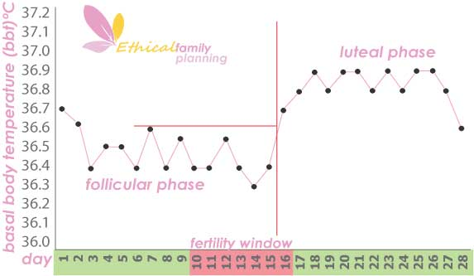
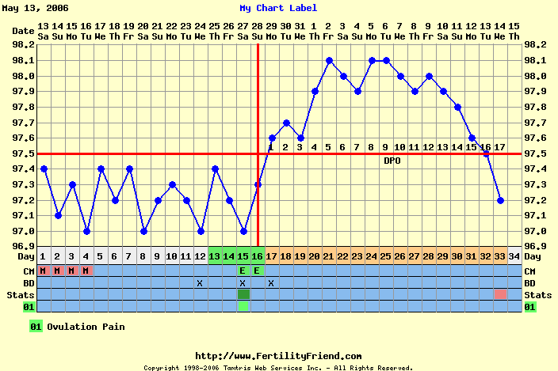

Slide 30
Menstrual Irregularities
Irregular cycles (short or long)
Getting periods less than 10 days after ovulation occurs
Severe pain with menstruation or intermittent pain throughout the cycle
Regular breakthrough bleeding throughout cycle
Any unusual discharge (yellow/green, lumpy white, smelly)

Slide 31
What you can do
Become aware of your cycle
Cervical mucus is the most important indicator
Use ovulation tests (LH Surge)
Basal temperatures
Time sex for 1-2 days prior to ovulation
Sex every second day is sufficient, abstinence is not recommended

Slide 32
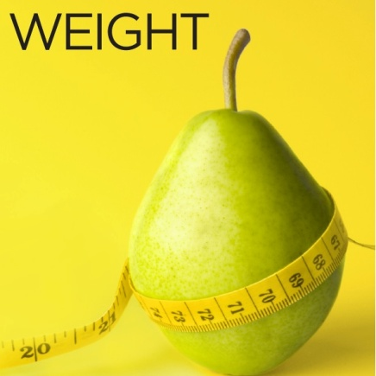
Female and male fertility decreased by being overweight or underweight
Healthy body weight for fertility BMI 18.5-25
BMI under 18.5 = underweight
BMI over 30.0 = obese
Women with a BMI over 30 have a longer time to pregnancy than women who have a BMI between 20 and 25
Women with a BMI of over 32 are not eligible for publicly funded fertility treatment in NZ
Anderson, K., Norman, R.J. and Middleton, P. “Preconception lifestyle advice for people with subfertility.”Cochrane Database Syst Rev 14, no.4 (2010) CD008189

Slide 33
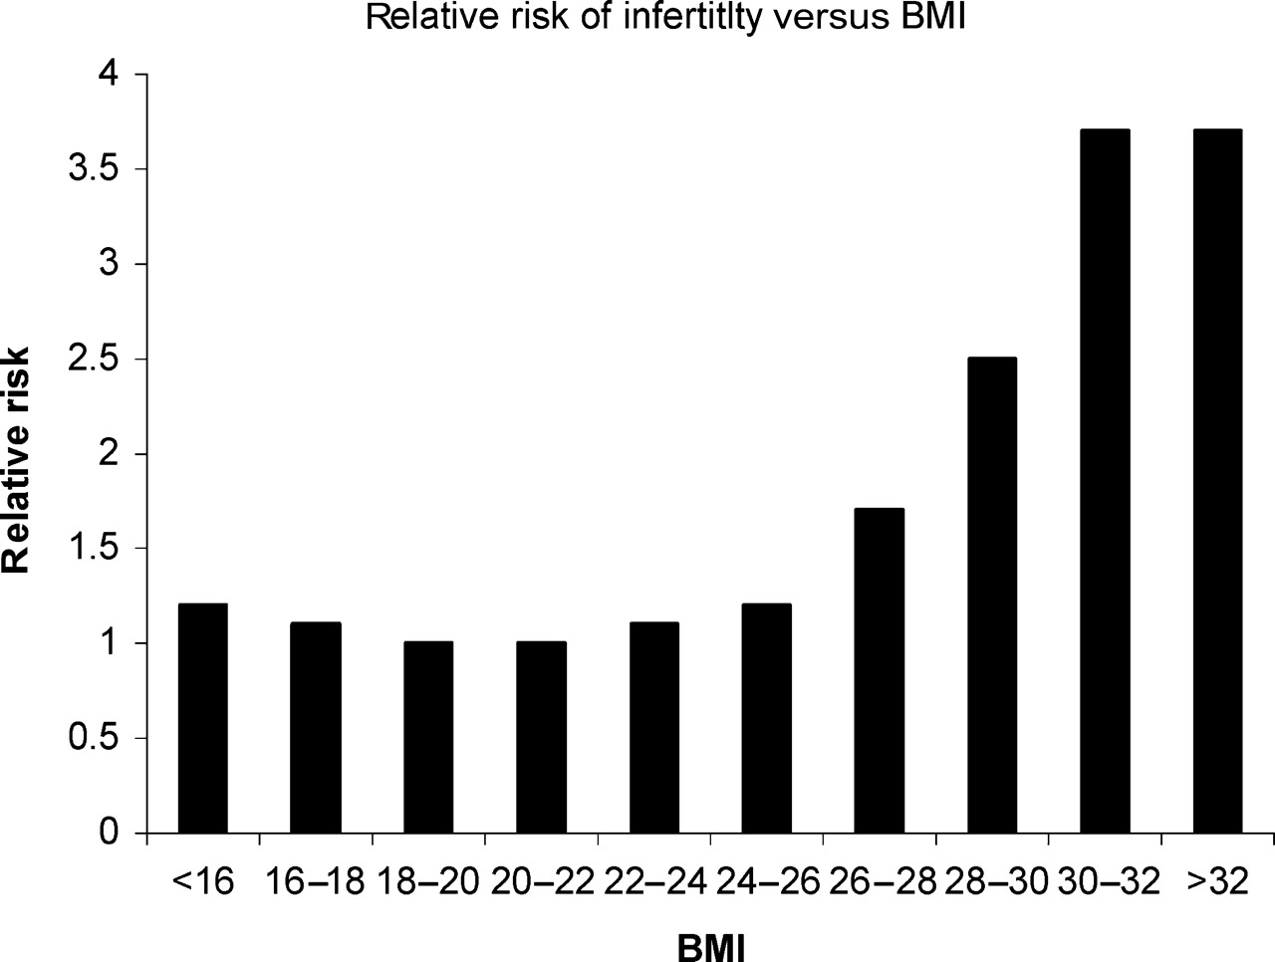
Impact of weight
Impact on ovulation
Relative risk of infertility if ovulating
Obstetric risk
Risk to the child
Anderson et al (2010) Preconception lifestyle advice for people with subfertility. Cochrane Database Syst Rev 14(4): CD008189
Homan et al (2007) The impact of lifestyle factors on reproductive performance in the general population and those undergoing infertility treatment: A review Hum Reprod Update 13(3):09-23

Slide 34
Overweight and obesity in pregnancy increases risk of
Miscarriage
Gestational diabetes
Pre-eclampsia
Premature births
Stillbirths
Perinatal mortality
Babies -> higher risk of obesity , CVD, diabetes
Callaway, L.K., Chang, A.M., McIntyre, H.D. and Johannes, B.P. “The prevalence and impact of overweight and obesity in an Australian obstetric population.” Medical Journal of Australia 184, no.2 (2006); 56-59

Slide 35
After losing an average of 10.2 kg, 90% of obese previously anovulatory women began ovulating.
Clark, A.M., Thornley, B., Tomlinson, L., Galletley,C. and Norman, R.J. “Weight loss in obese infertile women results in improvement in reproductive outcome for all forms of fertility treatment” Human Reproduction 11. (1998):1502–1505.

Slide 36
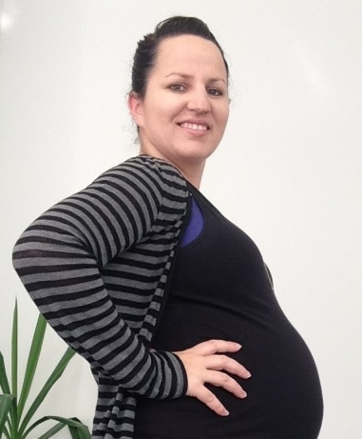
Aroha’s Story see Fertility Week site for the full story
I am 30 and my husband (Rawiri) is 32. We got married Labour Weekend in 2010 after being together for 9 years, we met when I was 18 and he was 20, it was our perfect day…
2011- Clomiphene for 9 months – never ovulated
2012 - Ovarian drilling (burnt holes in my ovaries to make into pool tables and egg would fall out, extremely painful) – surgery failed, no ovulation
2012 - Referred to Fertility specialists
2012- Gonal F (daily self-administered injections) – never ovulated…
…What is something you can do to get fit – sign up for Oxfam. Three friends and myself signed up. 30-50+ km walks most weekends. I hired a personal trainer three mornings a week. Played women’s outdoor soccer every Sunday. Formed an indoor soccer team and played for another 2+ games a week. I became a machine! But through pure determination and fear that I couldn’t say I gave it my all…
…I weighed at my heaviest 78kg, I was incredibly unhappy with my body but then I was incredibly unhappy every month. It’s the hardest thing I hope to ever have to go through…
…I believe with my everything that getting fit and dropping 10kg was a result of our pregnancy in August 2013. Today I am 27 weeks and 4 days pregnant with a little boy, our miracle.

Slide 37
Underweight
Underweight before pregnancy and poor weight gain during pregnancy result in:
Anovulation
Increased chance of pre-term delivery
Low birth weight infants
Poor nutritional status -> affects health of pregnancy and baby

Slide 38
Men
Obesity in men – increased risk of
Infertility
Impaired sperm quality and quantity
Decreased libido
Erectile dysfunction
Increased DNA damage
Hammoud, A., Meikle, A., Reis, L., Gisbon, M., Peterson, C. and Carrell, D. “Obesity and Male Infertility” Semin Reprod Med.30, no.6 (2012): 486-495

Slide 39
General Fertility Dietary Guidelines
Increase antioxidant rich foods – veges, fruit
Ensure adequate protein
Reduce saturated fats and trans fats, increase healthy fats
Reduce sugars and refined carbohydrates, increase whole grains
Avoid processed foods high in sugar, salt, additives, colourings, preservatives
Drink plenty of water – filtered where possible
Avoid coffee and caffeinated drinks
Eat organic where possible

Slide 40
The Dirty Dozen 2013
Food in New Zealand more likely to contain pesticide residues ranked according to number of pesticides detected in total samples and percentage with pesticides
Food % with residues no. of pesticides sample size
1.Grapes 98.2 35 562.
2.Celery 100 19 51
3.Bok/pak choi 95.7 21 47
4.Nectarines 100 15 36
5.Oranges 98.2 16 56
6.Strawberries 100 14 8
7.Spring onion 97.9 15 48
8.Lemons 92 20 50
9.Wheat: bread/all products 87.3 23 150
10.Cucumber 82.1 27 56
11.Pears 100 9 8
12.Broccoli 92.9 10 57
www.safefood.org.nz

Slide 41
Fertility Diet
Women – higher mono unsaturated to trans fat ratio, vegetable over animal protein, high fat over low fat dairy, a decreased glycaemic load and an increased intake of iron and multivitamins had lower rates of infertility due to ovulatory disorders
Chavarro JE, Rich Edwards JW, Rosner BA, Willett WC: Diet and lifestyle in the prevention of ovulatory disorder infertility. Obstet Gynecol 2007, 110:1050–1058.

Slide 42
Diet and IVF
Recent study exploring impact of preconception diet on IVF demonstrated that IVF women:
have too much saturated fat and insufficient fibre and calcium
some were not taking enough folic acid
many not following advice about caffeine and alcohol
Alice Redward (Fertility Associates and Liggins Institute)

Slide 43
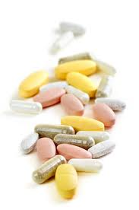
Supplements not a substitute for good healthy food
Women
800mcg folic acid before conception (>4 weeks) & for first trimester of pregnancy
150mcg iodine and throughout pregnancy / breastfeeding
OR combined prenatal supplement with adequate folic acid and iodine
Iron supplement if low iron levels
Omega 3 oils
Vitamin D
Notes:
The Blackmores pregnancy and breastfeeding gold supplement and the Blackmores Conceive Well supplement only supply 500mcg folic acid/day if taken in the recommended dosage. The iodine level is fine (150mcg).
Mention calcium (for women with low calcium, taking 1000-2000mg elemental calcium may reduce the risk of developing pre-eclampsia by around 50%), and vegans may need Vitamin B12 intramuscular injection of hydroxocobalamin 1000mcg/ampule before or during pregnancy.

Slide 44
Sperm health and antioxidants
A Cochrane review including 34 studies, determined that men who use oral antioxidants had a significant increase in live birth rate.
Showell MG, Brown J, Yazdani A, Stankiewicz MT, Hart RJ: Antioxidants for male subfertility. Cochrane Database of Systematic Reviews (Online) 2011.

Slide 45
Exercise
Regular moderate exercise (20-30 mins 5 x a week)
Physically active men who exercised at least three times a week for one hour typically scored higher in almost all sperm parameters in comparison to men who participated in more frequent and rigorous exercise
Excessive exercise can negatively affect fertility

Slide 46
A study examining 2,232 women undergoing in vitro fertilization (IVF) found that women who engaged in cardiovascular exercise for 4 hours or more per week for as little as one year prior to the treatment had a 40% decrease in live birth rate
Horman,G.F., Davies, M. and Norman,R. “The impact of lifestyle factors on reproductive performance in the general population and those undergoing infertility treatment: A review” Human Reproductive Update 13, No.3 (2007) 209-23

Slide 47
What you can do
Regular moderate exercise
Healthy diet
Intake of essential preconception / pregnancy vitamins and minerals
Women and men are equal contributors!

Slide 48
Decreases fertility rates – levels as low as 1 drink per week has been associated with reduced conception rates
Increases risk of miscarriage
Extreme levels = dangerous to unborn child
Effects at lower levels uncertain
Most vulnerable time for foetus is in first weeks of pregnancy (often undetected)
UNSW Australia. National Perinatal Epidemiology and Statistics Unit – Assisted Reproductive Technology in Australia and NZ 2011. http://www.npesu.unsw.edu.au/surveillance/assisted-reproductive-technology-australia-new-zealand-2011

Slide 49
Women
Alcohol ranging from 1 drink per week to 5 units per day can have the following effects
Anovulation
Luteal phase dysfunction
Delayed conception
Abnormal blastocyst formation
Increased risk of spontaneous abortion and foetal death
Impact on children’s cognitive and socio-emotional development
Woodruff, T.J., Carlson, A., Schwartz, M.P.H. and Giudice, L.C. “Proceedings of the Summit on Environmental Challenges to Reproductive health and Fertility” Fertility and Sterility 89, No.2 (2008):281-300

Slide 50
Men
Alcohol consumption in men linked to
Testicular atrophy
Decreased libido
Decreased semen volume
Decreased sperm numbers and quality
Woodruff, T.J., Carlson, A., Schwartz, M.P.H. and Giudice, L.C. “Proceedings of the Summit on Environmental Challenges to Reproductive health and Fertility” Fertility and Sterility 89, No.2 (2008):281-300

Slide 51
Current evidence inconclusive regarding safe dose of alcohol prior to and during pregnancy
WHO recommendation = avoid all alcohol during, or when planning a pregnancy

Slide 52
Marijuana
Males – reduce testosterone, spermatogenesis,
sperm motility
Women – impacts hormonal regulation and affects egg and embryo movement throughout oviducts
Negatively impacts placental and fetal development

Slide 53
Caffeine
Caffeine and recreational drugs also need consideration
Caffeine associated with increased time to conception
Dose – response effect
High levels during pregnancy -> increased risk of stillbirth
Limit coffee to 1 per day
Be aware of other sources of caffeine – including energy drinks and chocolate
Anderson, K., Norman, R.J. and Middleton, P. “Preconception lifestyle advice for people with subfertility.” Cochrane Database Syst Rev 14, no.4 (2010) CD008189

Slide 54
Caffeine and fertility
 | Effect on fertility
Negative effect | ↑ time to conceive (>300mg/day)¹
 | ↑ risk of spontaneous abortion (>150, >300, >375mg/day)
Negative effect on IVF | ↑ the risk of miscarriage and not achieving a live birth²
No effect | No negative effect of when adjusted for confounding lifestyle factors (100 – 200 mg/day)
 | No effect on spontaneous abortion
Homan et al (2007) The impact of lifestyle factors on reproductive performance in the general population and those undergoing infertility treatment: A review Hum Reprod Update 13(3):09-23
2. Klonoff-Cohen et al (2002) A prospective study of the effects of female amd male caffeine consumption and the reproductive endpoints of IVF and gamete intra-Fallopian transfer Hum Reprod 17(7):1746-1754.

Slide 55
What you can do
Women – avoid or limit alcohol pre-conceptually
Men – limit alcohol consumption
Women and men – avoid recreational drugs
Avoid or limit caffeine consumption

Slide 56
Cigarette smoke contains over 4000 chemicals
Associated with lower fertility rates, adverse reproductive outcomes, higher risk of IVF failure

Slide 57
Women
Decreases in ovarian function and ovarian reserve
Women who smoke 10 or more per day found to have 30-35% increase in urinary FSH
Women who smoke 20 or more had lower luteal phase progesterone
Windham GC, Mitchell P, Anderson M, Lasley BL: Cigarette smoking and effects on hormone function in premenopausal women. Environ Health Perspect 2005, 113:1285–1290.

Slide 58
Women
May impair oocyte pick up and transport of fertilised embryos within oviduct -> increased rate of ectopic pregnancies, longer time to conception
While using donor oocytes found that women who smoked 0-10 per day had higher pregnancy rates than those that smoked 20 or more per day -> compromised uterine environment
Soares SR, Simon C, Remohi J, Pellicer A: Cigarette smoking affects uterine receptiveness. Hum Reprod 2007, 22:543–547.

Slide 59
Men
Decrease in total semen volume, sperm count, motility, morphology, fertilising capacity, sperm DNA integrity, testosterone
Increase in erectile dysfunction
Appears to be in direct proportion to quantity of cigarettes smoked
Dechanet, C., Anahory, T., Daude, M., Reyftmann, L., Hamamah, S., Hedon, B. and Dechaud, H. “ Effects of cigarette smoking on reproduction.” Human Reproduction. Update 17, no.1 (2011):76-95

Slide 60
Pregnancy
Major cause of
preterm births
low birth weight babies
spontaneous abortions
Waylen, A.L., Metwally, M., Jones, G.L., Wilkinson, A.J. and Ledger, W.L. “Effects of cigarette smoking upon clinical outcomes of assisted reproduction: a meta-analysis.”Human Reproduction. Update 15,(2009):31-44

Slide 61
Women who smoke are ineligible for publically funded treatment (women need to have been non-smokers for at least three months).

Slide 62
Environmental Toxicity
Smoking is linked to other environmental toxins
Exposure to environmental contaminants (synthetic chemicals, heavy metals), during critical periods of development (before conception and during pregnancy), have potential effects on all aspects of future reproductive health
Woodruff, T.J., Carlson, A., Schwartz, M.P.H. and Giudice, L.C. “Proceedings of the Summit on Environmental Challenges to Reproductive health and Fertility” Fertility and Sterility 89, No.2 (2008):281-300

Slide 63
Environmental Toxicity
100,000 synthetic chemicals are available in the market
1500 new chemicals will be produced this year
Of 80,000 chemicals used in this country only 200 have been tested for safety.

Slide 64
10 new born babies
287 chemicals found in umbilical cord of these babies
Average of 200 chemicals
28 waste products e.g PCBs, mercury, lead
47 consumer products e.g fragrances, teflon
212 industrial chemicals and pesticides banned 30+ years ago
Of 287 chemicals
134 cause cancer in humans or animals
151 associated with causing birth defects
154 hormone disruption
186 infertility
130 immune system toxicity
150 neurotoxins
(Environmental Working Group Report)

Slide 65
Personal Care
Women use on average 12 personal care products a day, exposing them to more than 160 chemical ingredients every day.
-shampoo, conditioner, soap, lotion, moisturiser, toothpaste, deodorant etc
www.cosmeticsdatabase.com

Slide 66
Environmental Toxicity
Notes:
POPs – persist in envt and bio accumulate. Phthalates – used in solvents, lubricants, stabilisers, plasticisers – make plastics flexible. Found in toys, medical equipment, blood storage bags, cosmetics, perfumes, food packaging

Slide 67
Endocrine disruptors
Pesticides, insecticides, plastics, cosmetics
Mimic natural hormones
Impede normal hormonal activity
Various damaging effects on reproductive health
Sharma, R., Biedenham, K.R., Fedor, J. and Agarwa,l. “Lifestyle factors and reproductive health: Taking control of your fertility” Reprod Biol Endocrinol. 11( 2013):66

Slide 68
Radiation
Germ cells very sensitive to x rays and gamma rays
Cell phone usage linked to decreased sperm motility, morphology and numbers
Study(n=52) shows men who carry cell phone in hip pocket or around belt line have decreased sperm motility compared to men carrying them elsewhere
Kigallon, S.J. and Simmons, L.W. “Image content influences men's semen quality.” Biol Lett. 1, no.3, (2005): 253-5

Slide 69
Stress
Infertility = major stress
Stress undermines effective functioning of the immune system, adrenals, digestion and hormonal balance all of which contribute to the fertile state

Slide 70
Stress
Study of 373 women between 18 and 40 years linked stress to infertility
Stressed women half as likely to conceive in 12 months of trying
29% less likely to conceive each month
Simple remedy of light exercise or yoga could improve chances
Journal of Human Reproduction 2014

Slide 71
Are you Fertility Fit?
Take control of your fertility
Make a difference to the health of your baby and future generations

